Slide 1
SN Corporation Sales Analysis
Descriptive, Predictive & Prescriptive Analytics (Power BI Project)
Developed by: Bhoomi Parekh

Slide 2
Project Overview
• Analyze sales performance (2017–2020)
• Identify trends, regional & category insights
• Build forecast models using Power BI
• Provide data-driven business recommendations
Tools: Power BI | Excel Dataset | DAX | Forecasting Visuals

Slide 3
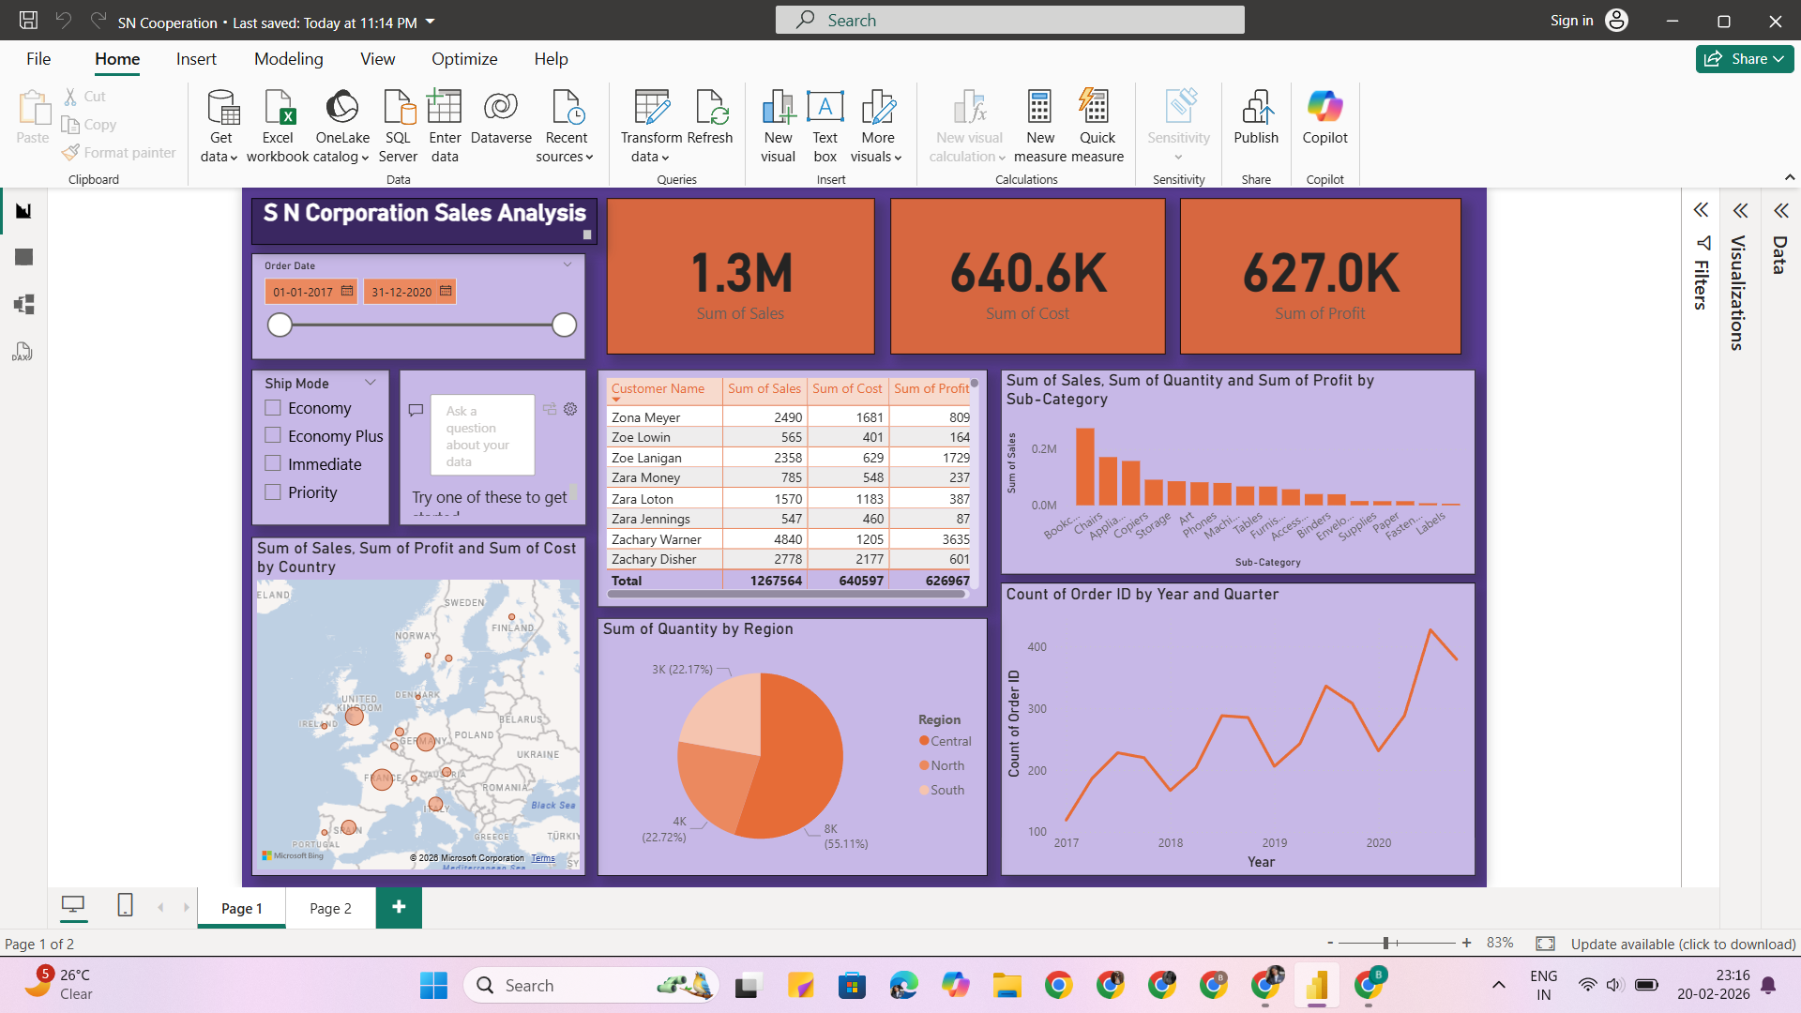
Descriptive Analytics Dashboard

Slide 4
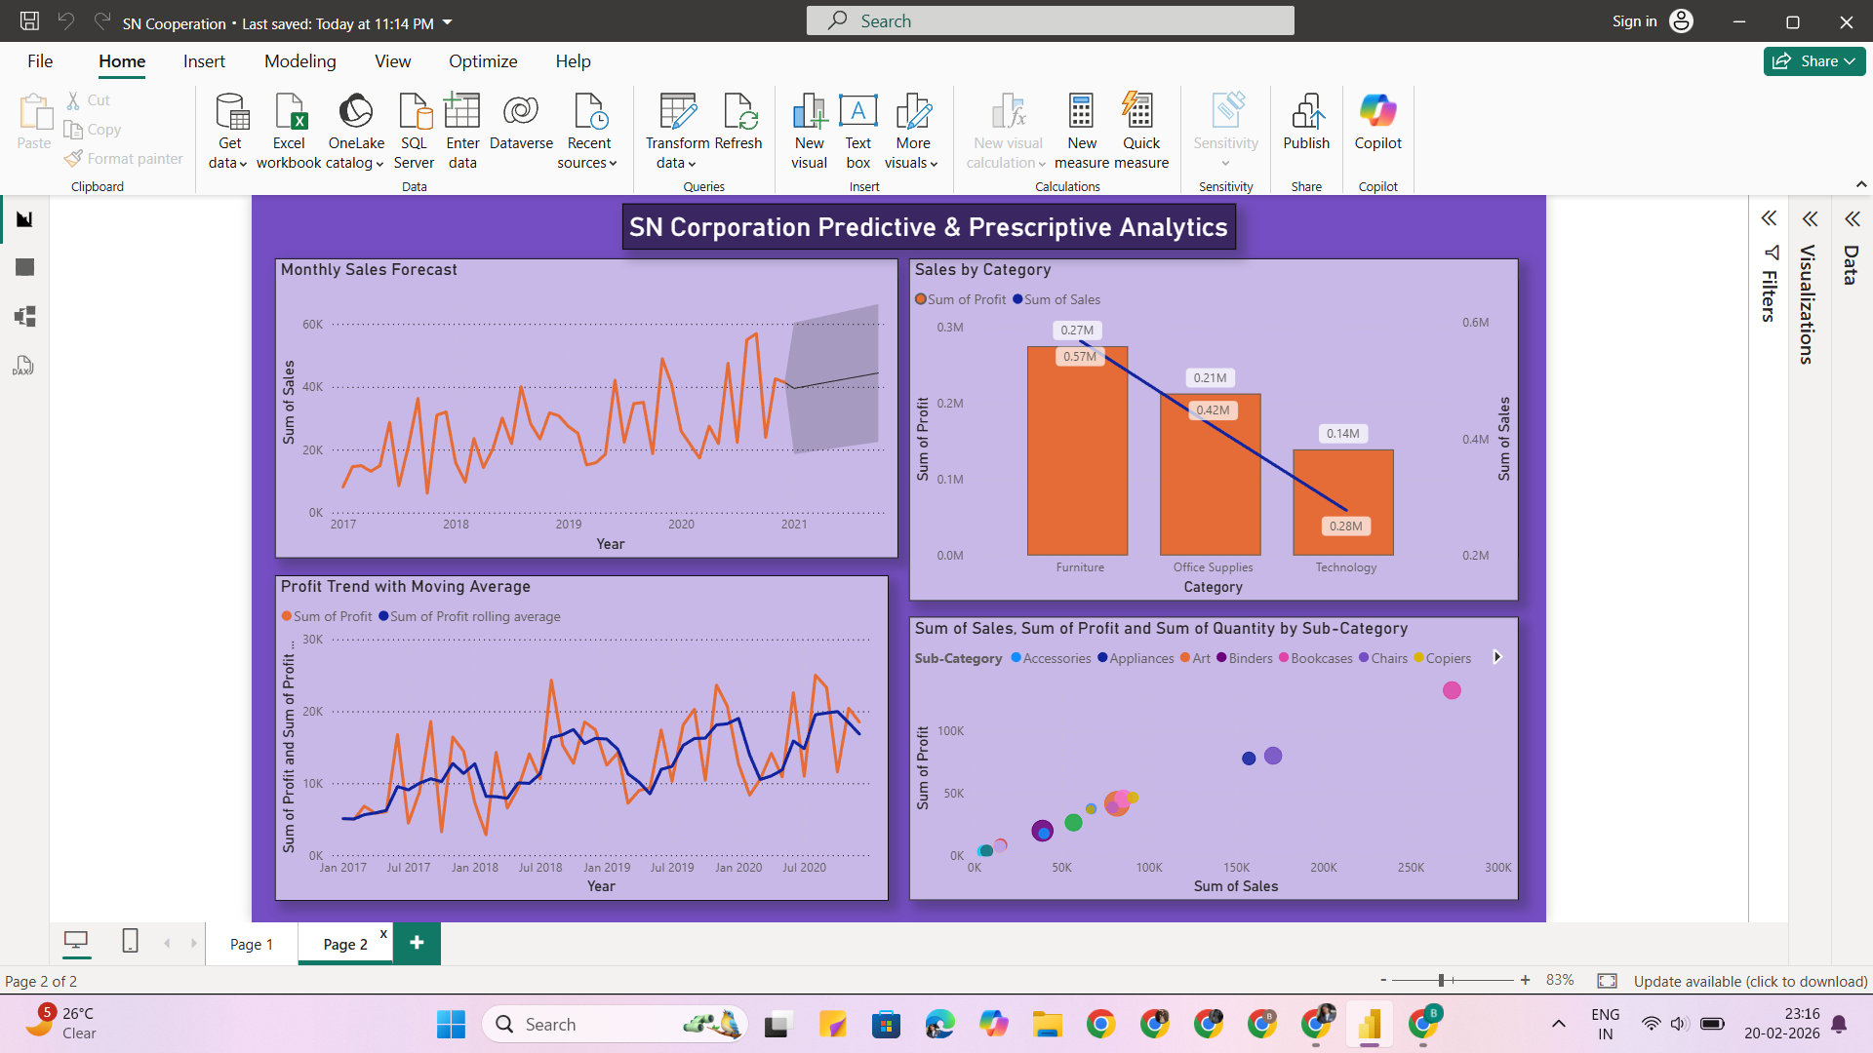
Predictive & Prescriptive Dashboard

Slide 5
Key Insights & Business Impact
• Total Sales: 1.3M | Profit: 627K (Strong Profitability)
• Upward sales growth trend across years
• Central region contributes highest quantity
• Furniture category generates strong profit
• Forecast indicates continued growth
Business Impact:
• Better inventory planning
• Strategic regional focus
• Data-driven marketing decisions

Slide 6
Conclusion & Future Scope
• Power BI enabled complete 360° sales analysis
• Combined descriptive, predictive & prescriptive analytics
• Interactive dashboards support real-time decisions
Future Scope:
• Machine Learning forecasting models
• Customer segmentation analysis
• Real-time cloud data integration

